Slide 1
STAT7001 – Computing for Practical Statistics 2015 Lecture 9
Non-Linear Models and Non-Linear Fitting
Dr Franz J. Király

Slide 2
Course organization updates
First ICA
Grading is likely to complete this week
Feedback will be available on your digital TurnitIn submission
Completion of grading will be announced over the news forum
Second ICA
Due Tuesday March 31, 11:55 pm – please try to submit in time
Please inform us if you have problems collaborating with your group
Course survey questionnaires
Thank you all for participating!
48 participants from both workshops (out of 98)
I will give a detailed reply to your comments

Slide 3
Non-Linear Modelling

Slide 4





What is Non-Linear Regression?
Estimation of non-linear dependence between continuous variables
e.g. weight
e.g. pulse

Slide 5

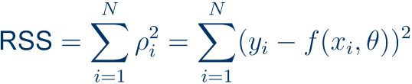
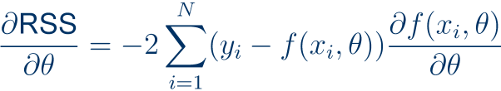
Non-linear Least-Squares Regression

Slide 6
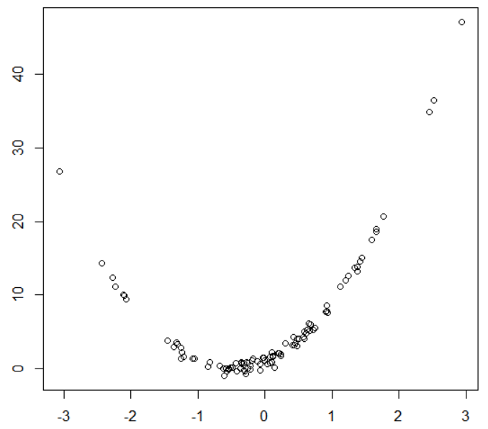
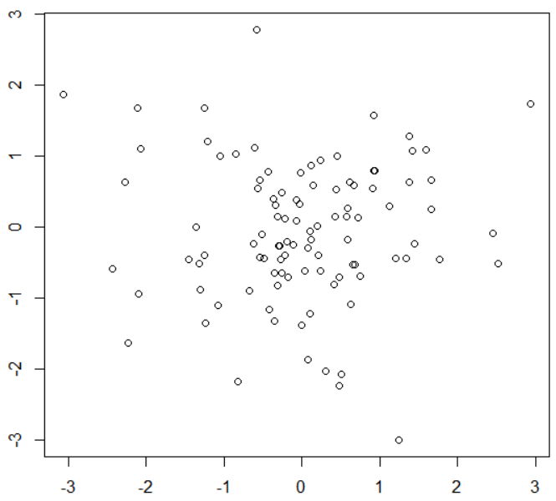
How to recognize non-linearity
1. from initial explorative analyses, e.g., histogram, scatterplot:
non-linear behaviour
this is just noise
Careful: do not mistake noise for non-linearity!
There should be strong evidence if choosing a non-linear model.

Slide 7
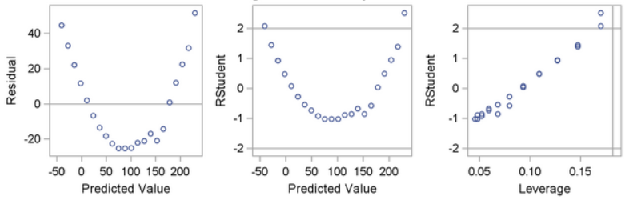
How to recognize non-linearity
2. in the diagnostic plots for a simpler model, e.g. the residual plot
Consider fitting the residuals and adding this as non-linear term
Caution: do not mistake noise for non-linearity.
3. if knowledge on the data suggests a particular relation
Examples:
logistic growth
supply/demand
formulae predicted by chemical/physical theory

Slide 8


How to recognize the type of non-linearity
investigate whether the model is…
linearizable
after transforming variables, the model is linear
find transormation and do linear OLS
sometimes transforming the target variable is better than fitting a GLM (below)
native GLM
the model is a GLM for an appropriate link function
find the link and fit a GLM
GLM-izable
a combination of the above
be careful that your model is not too complicated
find link and transformations, fit a GLM
non-linear
and none of the above
no reparameterization makes the model a GLM
specific non-linear methods are required here
e.g. parametric RSS minimization (discussed today)
Bayesian or non-parametric prediction
kernel ridge regression (machine learning)

Slide 9








Variable transformations
To linearize your model by single-variable transforms such as
Caution: only apply transformations when you know what you are doing!
do not apply transformations without prior explorative analysis!
do not randomly apply transformations until you get an ok fit!
do not apply transformations without reason to do so!
Caution: the residuals will be different, even if the model is equivalent
has residuals different from
Caution: if you transform the target variable, you are fitting a GLM
use GLM fitting and summary routines if you transform the target

Slide 10
Variable transformations in SAS and R
To linearize your model by single-variable transforms such as
In R: in the model formula, via log etc., and I(.)
glm(formula = y ~ log(x)+I(x^2)+I(z+log(x)),…)
some functions such as log can be directly applied to the variables
the formula element I(.) evaluates the in-brackets part as single variable
in the example above, there are variables x^2 and z+log(x)
In SAS: depends on the PROC, usually done by adding new variables
data mydatawithnonlinearvariables;
input …;
xsq = x*x;
makes a new variable for the x-squared term
ylogy = y + log(y);
makes a new variable for a y + log(y) -term
…
run;
then e.g. run PROC reg
alternative: use PROC transreg
(is also capable of finding suitable transforms)

Slide 11
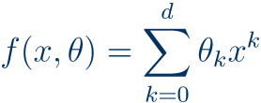
Special case: polynomial models
„polynomial model of degree k“
In R: in the model formula, via poly
glm(formula = y ~ poly(x,deg),…)
poly(x,deg) adds variables for each power of x
equivalent to I(x)+I(x^2)+ … +I(x^deg)
for multivariate polynomial, do poly(x,xdeg)*poly(y,ydeg)
In SAS: PROC glm or PROC orthoreg (or PROC model, later)
PROC glm allows specification of polynomial variable models by
model y = x|x;
(degree 2 in x)
model y = x|z;
(cross-term x*z)
PROC orthoreg has specific syntax for polynomial models:
effect xpoly = polynomial(x / degree = 42);
model y = xpoly;

Slide 12

Non-linear fitting in R
via the nls function
nonlinmodel <- nls(formula = …, data = …, start = …)
The formula parameter formula has the usual function syntax
not the model syntax as in glm
formula should use model variables
model variables are given with initial values by start
Example: logistic growth
nonlinmodel <-
nls(formula = y ~ beta1/(1+exp(beta2+beta3*x)),
data = datacontainingonlyxandynobetas,
start = list(beta1 = 1, beta2 = 1, beta3 = 1))
summary(nonlinmodel)
for an extensive model summary

Slide 13
Non-linear fitting in SAS
via the PROC model
PROC model data = mydata;
„target = f(vars)“;
this should be a formula with variables in mydata
fit target;
the fit statment specifies which variable is target
run;
if a variable in the formula is not in mydata, it will be interpreted as model variable
Example: logistic growth
PROC model data = mydata;
y = beta1/(1 + exp(beta2 + beta3*x));
fit y;
run;
if mydata has only variables x and y, the proc model will fit beta1,beta2,beta3
help model
http://www.okstate.edu/sas/v8/saspdf/ets/chap14.pdf

Slide 14

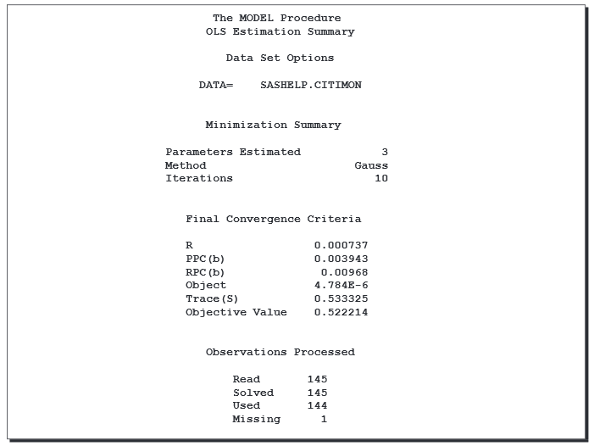
PROC model: sample output
Model variables
arguments of F:
free variables
is these the correct variables?
Optimization details
Number of free variables
Convergence criteria
change in free variables
Optimization objective
did the optimization converge?
data points used in likelihood
are these all data points?

Slide 15
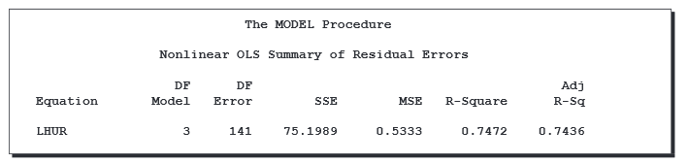
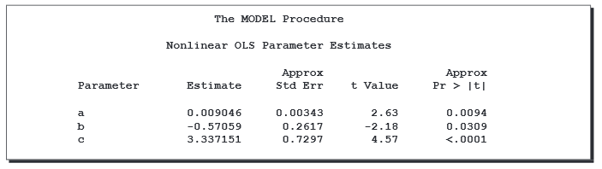
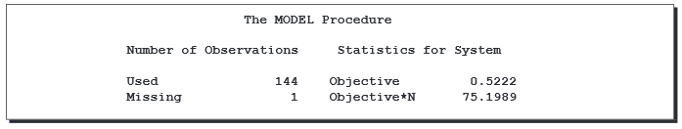
PROC model: sample output
Residual summaries
R-squared
adjusted R-squared
close to 1 is a good fit
model and error deg.f
sum of squared errors
mean squared error
DF model should be much smaller
(both are on the training data!)
Parameter estimates
Estimate + st.error
t-statistic
p-value
significance? proper range?
Objective residual MSEs
for multivariate fitting
univariate case:
same as MSE
(without degf correction)

Slide 16
Assessment of non-linear models
Standard diagnostic plots very similar to linear regression.
Residuals: look for remaining structure, skewness, non-linearity, outliers
Standardized residuals: same, with absolute value measure
QQ-plot: non-normality, check noise assumption
alternative transformation to make the residuals closer to Gaussian?
Leverage and Cook‘s distance: informative points, outliers
in R: via plot function
plot(mynonlinearmodel)
in SAS: usually plotted by standard
ensure graphical summaries and diagnostics are enabled by
ods graphics on;
prior to running PROC reg or PROC model

Slide 17
Occam‘s razor (semi-quantitative version)
best fit
error
generalization error
overfitting
underfitting
training error
model complexity

Slide 18


Example: Predicting the future

Slide 19


Example: Predicting the future
you would see the quadratic structure in the linear OLS residuals!

Slide 20
Example: Predicting the future
this model has no error on the training set! But is it a good model?

Slide 21

Which model is best?
best fit
error
generalization error
overfitting
underfitting
training error
model complexity
Never make your model more complicated than the data!

Slide 22
























Validation of predictive models
(see lecture 8)
?
„test labels“
„the truth“
generalizability assumption
„test data“
compare & quantify
„hold-out “
„out-of-sample“
„in-sample“
Model estimation
Prediction
??
e.g. regression, GLM, advanced methods
e.g. evaluating the regression model
„training data“
predictor
predictions
Always validate predictive models out-of-sample!
The only way to test goodness of prediction is actually observing prediction!
Validate and compare non-linear models by out-of-sample (R)MSE/MAE

Slide 23
Cross-validation:
training data 1
Predictor 1
errors 1,2,3
Predictor 2
test data
Predictor 3
training data 2
Predictor 1
errors 1,2,3
aggregate errors 1,2,3
all data
Predictor 2
test data
Predictor 3
training data 3
Predictor 1
errors 1,2,3
Predictor 2
test data 3
Predictor 3
comparison
select type of cross-validation depending on desired accuracy and available time
type of cross-v.
how to obtain training/test splits
pros/cons
1. divide data in k (almost) equal parts
good compromise between
k-fold
2. obtain k train/tests splits via:
runtime and accuracy
often: k=5
each part is test data exactly once
the rest of data is the training set
when k is small compared to data size
leave-one-out
= [number of data points]-fold
very accurate, high run-time
repeated sub-sampling
1. obtain a random sub-sample of
can be arbitrarily quick
training/test data of specified sizes
can be arbitrarily inaccurate
(train/test need not cover all data)
parameters: training/test size # of repetitions
(depending on parameter choice)
2. repeat 1. desired number of times
can be combined with k-fold

Slide 24
Caveats for non-linear modelling
Only fit a non-linear model when there is a good reason to do so
Clear non-linear structure in scatterplot, residuals (and not noise)
Theory predicts particular (simple) non-linear structure in data
Be careful not to overfit your model
The model should have considerably less degrees of freedom than the data
Do not randomly try out dozens of models until one fits – this is also overfitting
If you make a custom model: make sure it is identifiable/non-singular
The model parameters should be exactly identifiable from the data
(this is a theoretical property of the model and can be verifed mathematically)
If the model has redundancies, you should eliminate them before fitting
Evaluate and compare models by out-of-sample prediction error
Validate the full estimated model out-of-sample on unseen test data
If you made a custom function class that is only backed by heuristic: validate the model class on new data from similar scenarios
Look for overfitting by estimating the generalization error (MSE on test sample)

Slide 25
Next Week: Common Errors in Data Analysis
Frequent sources of confusion and misinterpretation
Comments and help on *your* errors in the ICA

Slide 26
Week 9 Learning Objectives
Non-linearity in data
Understand what non-linearity is
Understand the non-linear least squares model
How to determine the type of non-linearity
Seeing non-linearity in scatterplots and residual plots
Finding proper variable transforms in R/SAS
Distinguishing non-linearity from noise
Non-linear fitting in R and SAS
Making non-linear transforms for GLM
Defining non-linear models and fitting them
How to select a „good“ model amongst several

